Slide 1
Monthly Report
DEVELOPING A MODULAR AND ADAPTIVE POWER ELECTRONICS SYSTEM FOR ENERGY CONSTRAINED AUTOMATIC WEATHER STATIONS
“AWS ADAPTIVE & MODULAR DESIGN”
By
Tobias Newman Muhanguzi
(MPSE)
Supervisors
Dr. Roseline Akol Dr. Mary Nsabagwa
07/11/2025

Slide 2
Design Approach
Power Subsystem
Sensor Subsystem
Communication Subsystem
Converters
Sensor Nodes
GSM, LoRa, WiFi, & BLE
Battery Charger
Battery
    Modularity
    Adaptability
    Micro Energy Harvesting, Storage & Adaptive Management
  Hybrid communication and Protocol switching

Slide 3
System Block Diagram
Sensor Nodes
Repository
Internet
Gateway Board
GSM + LoRa
Modules
Logic Level
Shifter
RTC
SD
Microcontroller
LDO
DC – DC
Converter
Solar Panel
Battery
Charger
Battery

Slide 4
Research progress
Presented concept
Presented Proposal
Preparing for Proposal Report submission
Sorting APA referencing

Slide 5
AWS Project progress
Reviewed the previous designs
(gen.1 to 3)
Developed System Design Block Diagram
(As shown below)
Developed the first draft of schematic diagrams
(Had 3 boards)
Reduced the 3 boards to 2 boards
(As shown below)

Slide 6
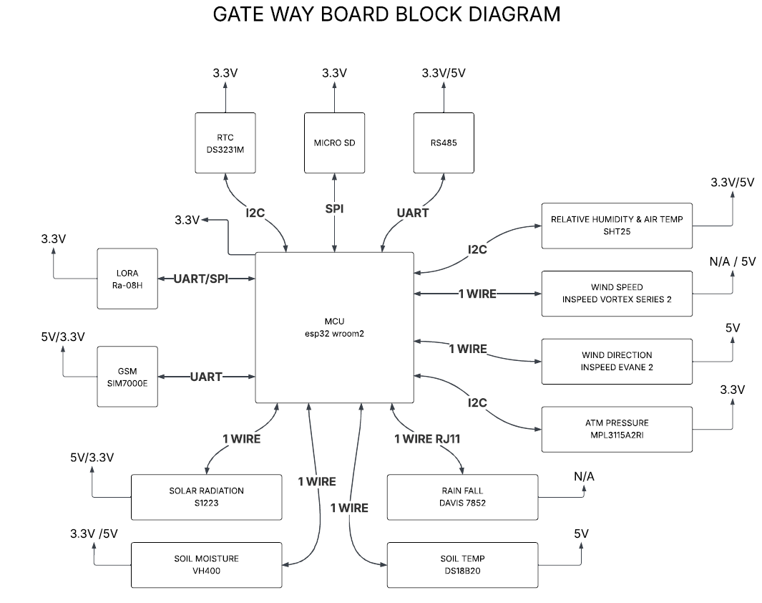
GW Design Block Diagram

Slide 7
Power Block diagram
Solar Panel
MUX
MPPT
BMS
DC Input
LDO
5V
Gateway Power Input

Slide 8
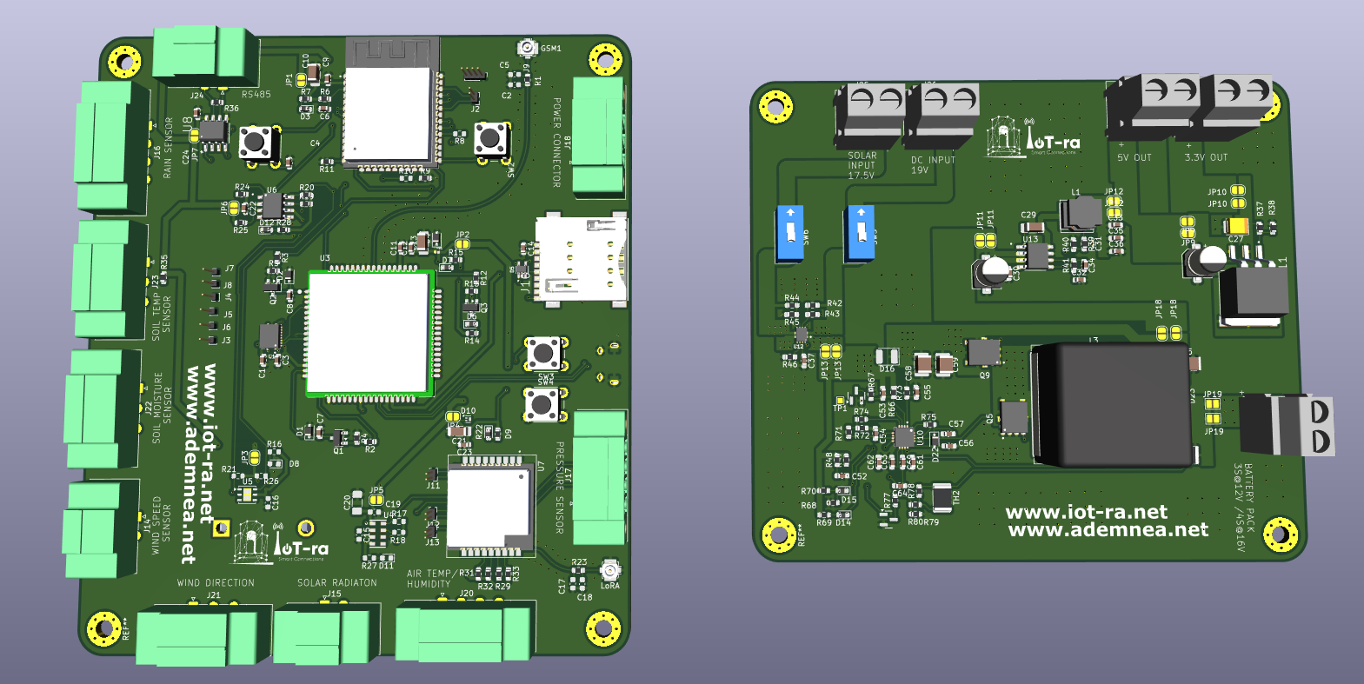
3D diagrams (FV)

Slide 9
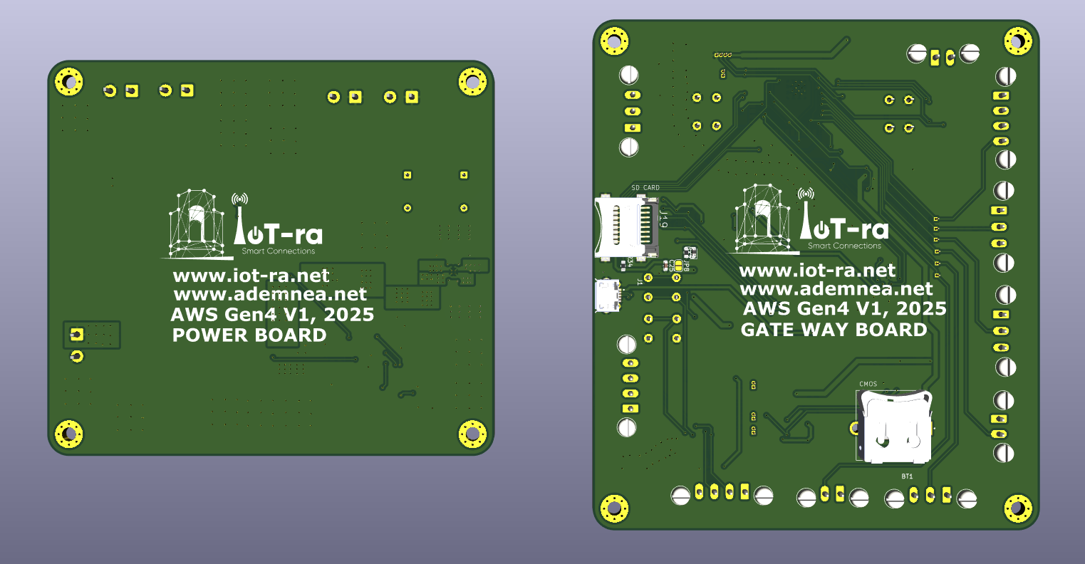
3D diagrams (BV)

Slide 10
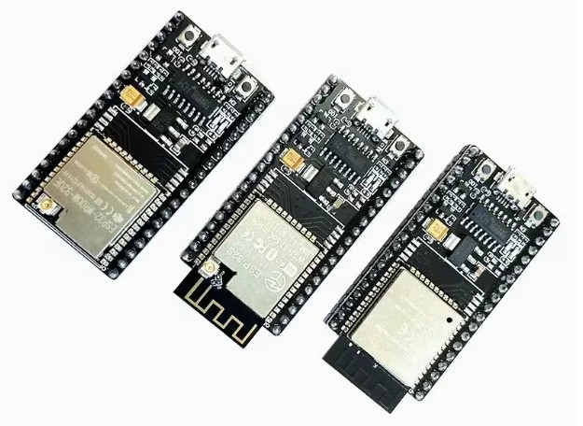
Proposed Design Modifications
Using molex connectors to enable water-proof container, this will mean substituting Available sensor connectors with molex connectors, eg. The rain gauge RJ-11…
For metallic container, ESP32 WROOM-U2 Will be substituted with ESP32-WROOM-32U

Slide 11
Pending Tasks
The prototype BOM of both boards will be available by (Thursday next week).
Prototyping to improve the design before printing the boards.
Hardware prototyping will be done starting 7th December. (This will take about 2 week.)
The two boards will be ready for printing by January
System assembly will be done the same month

Slide 12
Thank You

